Slide 1
FINA 1303 THE SHADOW MARKET: ALTERNATIVE INVESTMENTS
Veronique Lafon-Vinais
Associate Professor of Business Education - Department of Finance

Slide 2
Course Map
Overview
Foundations
of
Interest Rates
Financial Institutions
Pricing of Financial Assets
Regulations
DCF
Sell Side
Buy Side
Stock
Valuation
Banking Regulation
Basics of
Interest
Rates
Commercial
Banking
Traditional Institutional Investors
Monetary Policy
Investment Banking
Alternative Investors
2

Slide 3
Course Map
Overview
Financial Institutions
Sell Side
Buy Side
Sovereign Wealth Funds
Private Equity and Venture Capital
Hedge Funds
Commercial Banking
Traditional Institutional Investors
Investment Banking
Alternative Investors

Slide 4
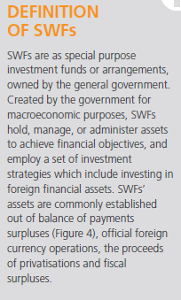
Definition of SWFs
http://www.swfinstitute.org/sovereign-wealth-fund/
Three key elements define an SWF:
Ownership: SWFs are owned by the general government, which includes both central government and subnational governments.
Investments: The investment strategies include investments in foreign financial assets, so it excludes those funds that solely invest in domestic assets.
Purposes and Objectives: Established by the general government for macroeconomic purposes, SWFs are created to invest government funds to achieve financial objectives, and (may) have liabilities that are only broadly defined, thus allowing SWFs to employ a wide range of investment strategies with a medium- to long-term timescale. SWFs are created to serve a different objective than, for example, reserve portfolios held only for traditional balance of payments purposes. While SWFs may include reserve assets, the intention is not to regard all reserve assets as SWFs.
Source: IMF, Santiago Principles
Source: The City UK SWF 2015
Notes:
Three key elements define an SWF
(Source: http://www.iwg-swf.org/pubs/eng/santiagoprinciples.pdf)
Ownership: SWFs are owned by the general government, which includes both central government and sub-national governments.41 41 Note that the use of the word arrangements as an alternative to funds allows for a flexible interpretation of the legal arrangement through which the assets can be invested. SWFs vary in their institutional arrangements, and the way they are recorded in the macroeconomic accounts may differ depending on their individual circumstances. See also the IMF’s Government Finance Statistics Manual, 2001.
Investments: The investment strategies include investments in foreign financial assets, so it excludes those funds that solely invest in domestic assets.
Purposes and Objectives: Established by the general government for macroeconomic purposes, SWFs are created to invest government funds to achieve financial objectives, and (may) have liabilities that are only broadly defined, thus allowing SWFs to employ a wide range of investment strategies with a medium- to long-term timescale. SWFs are created to serve a different objective than, for example, reserve portfolios held only for traditional balance of payments purposes. While SWFs may include reserve assets, the intention is not to regard all reserve assets as SWFs.42 42 Likewise, the intention is not to exclude all assets on the books of central banks: SWFs can be on the books of central banks if they also are held for purposes other than balance of payments purposes (e.g., as intergenerational wealth transfer)
Furthermore, the reference in the definition that SWFs are “commonly established out of balance of payments surpluses, official foreign currency operations, the proceeds of privatizations, fiscal surpluses, and/or receipts resulting from commodity exports” reflects both the traditional background to the creation of SWFs—the revenues received from mineral wealth - and the more recent approach of transferring “excess reserves.”
From The City UK “SWFs” 2012: http://www.thecityuk.com/research/our-work/reports-list/sovereign-wealth-funds-2012/
Definition of SWFs
SWFs are defined as special purpose investment funds or arrangements, owned by the general government. Created by the government for macroeconomic purposes, SWFs hold, manage, or administer assets to achieve financial objectives, and employ a set of investment strategies which include investing in foreign financial assets. SWFs’ assets are commonly established out of balance of payments surpluses , official foreign currency operations, the proceeds of privatisations, fiscal surpluses, and receipts
resulting from commodity exports

Slide 5
SWFs global presence (AuM)
Source: Prequin SWF 2018 report

Slide 6
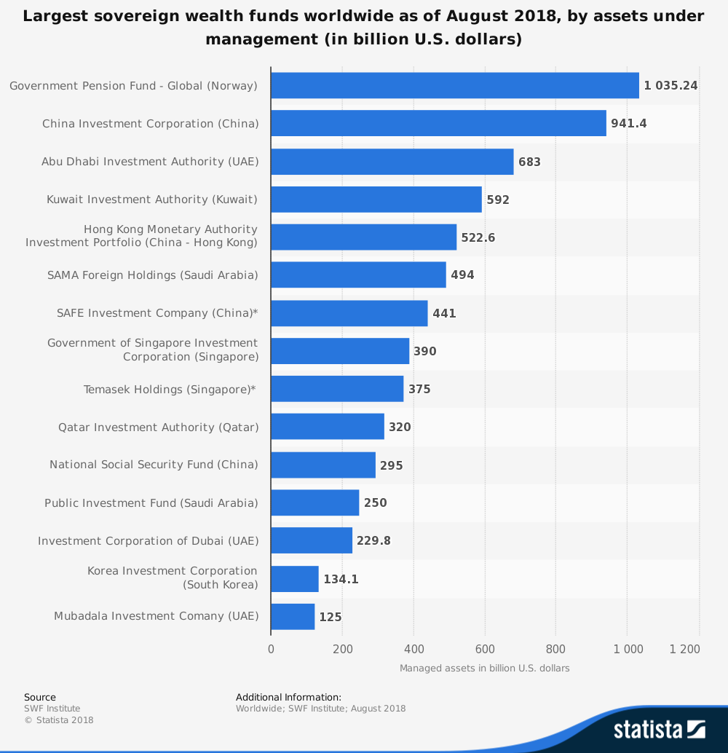
Top SWFs by AuM as of Aug 18
Notes:
Source: Statistica https://www.statista.com/statistics/276617/sovereign-wealth-funds-worldwide-based-on-assets-under-management/

Slide 7
Concerns about SWFs
Size & market impact
Growth of sector
Political issues: national security concerns and protectionism
Disclosure & transparency:
the International Working Group of Sovereign Wealth Funds (IWG) was formed in May 2008, with the IMF providing support in the form of a secretariat.
In October 2008, the Group published a set of 24 voluntary Principles, the Generally Accepted Principles and Practices for Sovereign Wealth Funds, known as the Santiago Principles
The IWG reached a consensus in April 2009 on the establishment of the International Forum of Sovereign Wealth Funds to follow up on the work undertaken in the context of the Santiago Principles. The Forum is a voluntary group of SWFs which meets at least once a year to exchange views on issues of common interest, facilitate an understanding of the Santiago Principles and SWFs activities, and encourage cooperation with investment recipient countries.
Notes:
Source: http://www.thecityuk.com/research/our-work/reports-list/sovereign-wealth-funds-2015/
International policy issues
SWFs bring significant benefits to global capital markets in terms of increasing market liquidity and financial resource allocation. Some governments however have expressed reservations about SWFs because of the limited disclosure and transparency of some SWFs. Another concern is that SWFs may invest to secure control of strategically important businesses or sectors for political rather than commercial reasons, and could use these investments to advance their own national interests.
In response to these concerns the International Working Group of Sovereign Wealth Funds (IWG) was formed in May 2008, with the IMF providing support in the form of a secretariat. In October 2008, the Group published a set of 24 voluntary Principles, the Generally Accepted Principles and Practices for Sovereign Wealth Funds, known as the Santiago Principles. Initial indications are that some SWFs have made progress in improving transparency, with more publishing annual reports and disclosing their assets under management. For example the Abu Dhabi Investment Authority published its first annual report and accounts in March 2010. But there remains a wide dispersion in the extent of transparency. Typically Asian SWFs achieved a higher rate of compliance while some Middle Eastern SWFs are lagging in initiatives to improve compliance. The IWG reached a consensus in April 2009 on the establishment of the International Forum of Sovereign Wealth Funds to follow up on the work undertaken in the context of the Santiago Principles. The Forum is a voluntary group of SWFs which meets at least once a year to exchange views on issues of common interest, facilitate an understanding of the Santiago Principles and SWFs activities, and encourage cooperation with investment recipient countries.
On the recipient country side, the OECD published guidance in 2008 on recipient country policies towards SWFs. Recipient countries should strive to avoid protectionism and uphold fair and transparent investment frameworks.
A forum for public-private sector interactions, the Official Monetary and Financial Institutions Forum (OMFIF), held its inaugural meeting at the beginning of 2010, to facilitate discussions between Western central banks and the SWF community.
Source: http://www.swfinstitute.org/swf.php
Current Trends
Size and Growth Since 2005, at least 17 sovereign wealth funds have been created. As other countries grow their currency reserves they will seek greater returns. Their growth has also been skyrocketed by rising commodity prices especially oil & gas, especially between the years of 2003 - 2008.
Transparency & Protectionism
Has anyone ever heard of UAE's Dubai World's Port Deal or China's CNOOC's bid for Unocal? Or how about the latest foreign bailout for the largest US Financial Institutions such as Citigroup, Morgan Stanley, and Merrill Lynch? Many SWFs are non-transparent, meaning they do not report their holdings or strategies to the Public. Some experts say they are passive investments, while others fear they are a matter of national security. These are causes for concern for many people, investors, and governments; and will eventually fuel the fires of protectionism. Learn more about the Linaburg Maduell Transparency Index
Sovereign Wealth Enterprise (SWE)
Another interesting trend is the development of sovereign wealth enterprises (SWE) which are investment vehicles that are owned and controlled by sovereign wealth funds. These vehicles allow greater flexibility for SWFs.
Source: http://www.ifsl.org.uk/upload/CBS%20Sovereign%20Wealth%20Funds%202010.pdf

Slide 8
Current issues: Sovereign Wealth Funds in Asia: example of recent investments and controversy surrounding it(Group 18)
Videos:
https://www.youtube.com/watch?v=1ePFLkf0KMw
Articles:
https://news.sky.com/story/softbank-and-abu-dhabi-fund-eye-government-tilt-at-satellite-group-oneweb-12019739

Slide 9
SUMMARY
Key elements in the definition
Concerns
Santiago Principles

Slide 10

Test Your Understanding
Which of the following is NOT a key element of SWFs:
Owned by the general government
Invests solely in domestic assets
Invests to achieve financial objectives
Invests on a global basis
Which voluntary code of conduct did major SWFs sign?
Equator Principles
Santiago Principles
Basel Principles
New York Principles

Slide 11
Course Map
Overview
Financial Institutions
Sell Side
Buy Side
Sovereign Wealth Funds
Private Equity and Venture Capital
Hedge Funds
Commercial Banking
Traditional Institutional Investors
Investment Banking
Alternative Investors

Slide 12
Venture Capital and Private Equity: agenda today
Definition of VC
Definition of PE
PE vs. VC?
Investment stages
Current issues
Notes:
Venture capital is a means of providing long term equity funding to young fast growing companies. It is often called "direct investment" or "private equity investment". There are three main types of private equity transactions: startup venture capital, development capital and buyouts.
Companies require funds to develop their business. Financial support can take the form of loans and/or equity capital. A company not listed on a stock exchange can obtain funds from banks or by issuing shares to private investors. Venture capital companies inject funds into the company in exchange for a proportion of its equity.
Venture capital firms are prepared to assume considerably higher risk by investing at the early stages of a company's development in the hope that they can reap higher returns if the company meets or exceeds its projections.
Venture capital firms realize their returns when an investee company has built a successful track record to qualify for listing on the stock exchange. Other means of exiting from investments are management buy-backs through put options based on a pre-determined formula, private placements to interested third parties or an outright or partial trade sale
Source: http://www.hkvca.com.hk/2004/m2-set.htm Hong Kong Venture capital Association

Slide 13
SOURCES OF CAPITAL FOR STARTUPS
ICOs
Family Offices
Angel Investors
Venture Capital Firms
Incubators/Accelerators
Corporates
Private Equity
Capital Markets
Venture Debt
Source: courtesy of Nick Adams and Differential Ventures

Slide 14
Angel Investors
Individuals – not funds
Invest their own money – not OPM
Typically HNWI and successful entrepreneurs
Hunt alone or in groups (angel groups, angel networks)
Motivation generally beyond pure financial returns
Investment horizon could be very long
Typically very early stage investing: seed money, start-ups….

Slide 15
Venture Capital (VC)
Venture capital is money provided by professionals who invest alongside management in young, rapidly growing companies that have the potential to develop into significant economic contributors. Venture capital is an important source of equity for start-up companies.
Professionally managed venture capital firms generally are private partnerships or closely-held corporations funded by private and public pension funds, endowment funds, foundations, corporations, wealthy individuals, foreign investors, and the venture capitalists themselves.
Source: NVCA (National Venture Capital Association)

Slide 16
Venture Capital (VC) (Cont’d)
Venture capitalists generally:
Finance new and rapidly growing companies
Purchase equity securities
Assist in the development of new products or services
Add value to the company through active participation
Take higher risks with the expectation of higher rewards
Have a long-term orientation
Source: NVCA (National Venture Capital Association)
Notes:
Venture capital (VC) is financial capital provided to early-stage, high-potential, growth startup companies. The venture capital fund makes money by owning equity in the companies it invests in, which usually have a novel technology or business model in high technology industries, such as biotechnology, IT, software, etc. The typical venture capital investment occurs after the seed funding round as growth funding round (also referred as Series A round) in the interest of generating a return through an eventual realization event, such as an IPO or trade sale of the company.
In addition to angel investing and other seed funding options, venture capital is attractive for new companies with limited operating history that are too small to raise capital in the public markets and have not reached the point where they are able to secure a bank loan or complete a debt offering. In exchange for the high risk that venture capitalists assume by investing in smaller and less mature companies, venture capitalists usually get significant control over company decisions, in addition to a significant portion of the company's ownership (and consequently value).
Venture capital is also associated with job creation (accounting for 21% of US GDP),^{[1]} the knowledge economy, and used as a proxy measure of innovation within an economic sector or geography. Every year there are nearly 2 million business created in the USA, and only 600-800 get venture capital funding. According to the National Venture Capital Association 11% of private sector jobs come from venture backed companies and venture backed revenue accounts for 21% of US GDP.

Slide 17
WHAT DOES A VC DO?
Raise capital from LPs
Source deals and invest capital
Manage our portfolio companies and follow-on investments
Generate returns through liquidity events
Meeting accredited investors
Family offices
Institutional investors [future funds]
VC partnerships
Angel investors
Investment banks
Service providers
Networking events
Founder network
Corporate partnerships
Constant ‘hustle’
Board representation
Full service operational support
Global expansion
Introduce corporate partners and customers
Help raise additional capital
Early identification of M&A partners
Manage liquidity opportunities through secondary markets, M&A and IPO
Source: courtesy of Nick Adams and Differential Ventures

Slide 18
Structure of a generic Venture Capital Fund
Venture Capital Firm
(General Partner)
Limited Partners (Investors)
(public pension funds, corporate pension funds, insurance companies, high net-worth individuals, family offices, endowments, foundations, fund-of-funds, sovereign wealth funds, etc.)
Ownership of the Fund
Fund/Investment
Management
Venture Capital Fund
(Limited Partner)
The Fund’s ownership of the portfolio investments
Investment
Investment
Investment
Notes:
Source: Wikipedia http://en.wikipedia.org/wiki/Venture_capital
Roles
Within the venture capital industry, the general partners and other investment professionals of the venture capital firm are often referred to as "venture capitalists" or "VCs". Typical career backgrounds vary, but broadly speaking venture capitalists come from either an operational or a finance background. Venture capitalists with an operational background tend to be former founders or executives of companies similar to those which the partnership finances or will have served as management consultants. Venture capitalists with finance backgrounds tend to have investment banking or other corporate finance experience.
Although the titles are not entirely uniform from firm to firm, other positions at venture capital firms include:
Venture partners – Venture partners are expected to source potential investment opportunities ("bring in deals") and typically are compensated only for those deals with which they are involved.
Principal – This is a mid-level investment professional position, and often considered a "partner-track" position. Principals will have been promoted from a senior associate position or who have commensurate experience in another field such as investment banking or management consulting.
Associate – This is typically the most junior apprentice position within a venture capital firm. After a few successful years, an associate may move up to the "senior associate" position and potentially principal and beyond. Associates will often have worked for 1–2 years in another field such as investment banking or management consulting.
Entrepreneur-in-residence (EIR) – EIRs are experts in a particular domain and perform due diligence on potential deals. EIRs are engaged by venture capital firms temporarily (six to 18 months) and are expected to develop and pitch startup ideas to their host firm (although neither party is bound to work with each other). Some EIR's move on to executive positions within a portfolio company.
Structure of the funds
Most venture capital funds have a fixed life of 10 years, with the possibility of a few years of extensions to allow for private companies still seeking liquidity. The investing cycle for most funds is generally three to five years, after which the focus is managing and making follow-on investments in an existing portfolio. This model was pioneered by successful funds in Silicon Valley through the 1980s to invest in technological trends broadly but only during their period of ascendance, and to cut exposure to management and marketing risks of any individual firm or its product.
In such a fund, the investors have a fixed commitment to the fund that is initially unfunded and subsequently "called down" by the venture capital fund over time as the fund makes its investments. There are substantial penalties for a Limited Partner (or investor) that fails to participate in a capital call.
It can take anywhere from a month or so to several years for venture capitalists to raise money from limited partners for their fund. At the time when all of the money has been raised, the fund is said to be closed and the 10 year lifetime begins. Some funds have partial closes when one half (or some other amount) of the fund has been raised. "Vintage year" generally refers to the year in which the fund was closed and may serve as a means to stratify VC funds for comparison. This free database of venture capital funds shows the difference between a venture capital fund management company and the venture capital funds managed by them

Slide 19
HOW VENTURE CAPITAL WORKS
FUND STRUCTURE
M&A
Co. 1
General Partners
(GPs)
IPO
Limited Partners
(LPs)
Co. 2
Exit?
2nd Market
Co. 3
RIP
Co. n
Paid y%*.8 of proceeds
Paid y%*.2 of proceeds
Paid x% of proceeds
Source: courtesy of Nick Adams and Differential Ventures

Slide 20
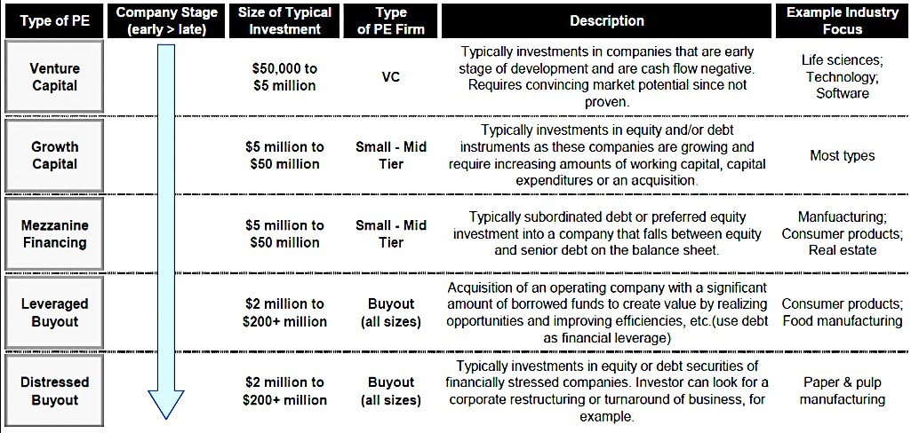
VC IN THE PRIVATE EQUITY MATRIX
Source: courtesy of Nick Adams and Differential Ventures

Slide 21
Private Equity
Definition: Equity investments in nonpublic companies
Equity capital that is made available to companies or investors, but not quoted on a stock market. The funds raised through private equity can be used to develop new products and technologies, to expand working capital, to make acquisitions, or to strengthen a company's balance sheet.
By extension, any investment in equity other than publicly listed equity
Currently private equity refers mainly to buy-out funds
Pricing in private markets is different than public markets as there should be a premium for illiquidity → PE should be more expensive
Notes:
Private equity - Private equities are equity securities of unlisted companies. Private equities are generally illiquid and thought of as a long-term investment. Private equity investments are not subject to the same high level of government regulation as stock offerings to the general public. Private equity is also far less liquid than publicly traded stock.
Source: http://www.angelscorner.com/glossary/venture-capital.htm
Equity securities of companies that have not "gone public" (are not listed on a public exchange). Private equities are generally illiquid and thought of as a long-term investment. As they are not listed on an exchange, any investor wishing to sell securities in private companies must find a buyer in the absence of a marketplace. In addition, there are many transfer restrictions on private securities. Investors in private securities generally receive their return through one of three ways: an initial public offering, a sale or merger, or a recapitalization.
Source: http://vcexperts.com/vce/library/encyclopedia/glossary_view.asp?glossary_id=89
Equity capital that is made available to companies or investors, but not quoted on a stock market. The funds raised through private equity can be used to develop new products and technologies, to expand working capital, to make acquisitions, or to strengthen a company's balance sheet.
Source: http://www.answers.com/private+equity&r=67
Private equity, in finance, is an asset class consisting of equity securities in operating companies that are not publicly traded on a stock exchange.^{[1]}
Most common investment strategies in private equity are: leveraged buyouts, venture capital, growth capital, distressed investments and mezzanine capital.

Slide 22
Definition of PE
Source: McKinsey Global Private Markets review 2017
Notes:
From McKinsey Global Private Markets review 2017

Slide 23
Private Equity - Industry
Growth
Buyout
Distress
Mez
Venture
Global
Regional
Country
Sector
Control
Strategy
Focus
Partner-
ship
Dictator
Corporate
Direct
Secondary
Fund-of- Fund
Level
Organisation
Source: HKVCA

Slide 24
Private Equity: Fee structure and performance
Fee structure
High “friction costs” (various fees, operating costs and inefficiencies that reduce return on investment) of around 11% per year
Typical fee structure:
2% fee on committed capital and 4% on average invested capital;
20% of profits;
acquisition fees, disposal fees, fees charged to companies and legal fees add probably another 2%
However leverage reduces the impact of friction costs
Performance

Slide 25
Private Equity Glossary
Leveraged buyout: Also called LBO or buyout, this is a strategy financial sponsors employ to acquire a majority stake in a company, business unit or business assets from the current shareholders, typically using a combination of equity and debt. The target companies involved in these transactions are typically mature and generate healthy operating cash flows.
Venture capital: This is an equity investment made to finance the launch, early development or expansion of a business. Venture investing is most often found in the application of new technology, new marketing concepts and new products that have yet to be proven, and it usually involves acquiring a minority stake in the business.

Slide 26
Private Equity Glossary (Cont)
Growth capital: This is an equity investment made most often to acquire a minority position in a relatively mature company that is looking to expand or restructure operations, enter new markets or finance a major acquisition without ceding control of the business.
Distressed investments: Distressed, or special, situations are a broad category referring to investments into financially troubled companies. Investors may acquire debt securities in anticipation of taking control of the company’s equity after a corporate restructuring. Investors may also provide “rescue financing” typically a combination of debt and equity to companies undergoing operational or financial challenges.
Notes:
Source: The social and economic impact of PE in China, Bain & Co, 2009 survey
Private equity glossary
The most common investment strategies in private equity include leveraged buyouts, venture capital, growth capital, distressed investments.
Leveraged buyout: Also called LBO or buyout, this is a strategy financial sponsors employ to acquire a majority stake in a company, business unit or business assets from the current shareholders, typically using a combination of equity and debt. The target companies involved in these transactions are typically mature and generate healthy operating cash flows.
Venture capital: This is an equity investment made to finance the launch, early development or expansion of a business. Venture investing is most often found in the application of new technology, new marketing concepts and new products that have yet to be proven, and it usually involves acquiring a minority stake in the business.
Growth capital: This is an equity investment made most often to acquire a minority position in a relatively mature company that is looking to expand or restructure operations, enter new markets or finance a major acquisition without ceding control of the business.
Distressed investments: Distressed, or special, situations are a broad category referring to investments into financially troubled companies. Investors may acquire debt securities in anticipation of taking control of the company’s equity after a corporate restructuring.
Investors may also provide “rescue financing” typically a combination of debt and equity to companies undergoing operational or financial challenges.
Limited Partner (LP): A LP is an investor in a fund. It has a share of ownership in a private equity partnership but takes no part in managing it. LPs are liable only up to the amount of their original investment in the partnership.
General Partner (GP): A GP is a fund manager. He takes part in the daily operations of the private equity partnership and is personally responsible for its liabilities.
Fund of Funds: It is a pool of capital that invests in several private equity funds. Its own investors are large institutional investors like pension funds or insurance companies. High net worth individuals and relatively small institutional investors participate in a fund of funds to minimize the effort and costs related to managing their portfolio.

Slide 27
LBO Diagram
Bank debt/ Senior credit facility
Target Company
Existing lenders and bondholders
Financial Sponsor (GP)
Limited Partners
High yield/ Mezzanine debt
LBO
Purchase
Price
Proceeds
Selling
Shareholders
Private Equity
(Preferred/ Common Stock)
Private Equity Fund (Limited Partnership)
Notes:
Source: http://en.wikipedia.org/wiki/File:Leveraged_Buyout_Diagram.png
Leveraged buyout, LBO or Buyout refers to a strategy of making equity investments as part of a transaction in which a company, business unit or business assets is acquired from the current shareholders typically with the use of financial leverage. The companies involved in these transactions are typically mature and generate operating cash flows.
Leveraged buyouts involve a financial sponsor agreeing to an acquisition without itself committing all the capital required for the acquisition. To do this, the financial sponsor will raise acquisition debt which ultimately looks to the cash flows of the acquisition target to make interest and principal payments. Acquisition debt in an LBO is often non-recourse to the financial sponsor and has no claim on other investment managed by the financial sponsor. Therefore, an LBO transaction's financial structure is particularly attractive to a fund's limited partners, allowing them the benefits of leverage but greatly limiting the degree of recourse of that leverage. This kind of financing structure leverage benefits an LBO's financial sponsor in two ways: (1) the investor itself only needs to provide a fraction of the capital for the acquisition, and (2) the returns to the investor will be enhanced (as long as the return on assets exceeds the cost of the debt).
As a percentage of the purchase price for a leverage buyout target, the amount of debt used to finance a transaction varies according the financial condition and history of the acquisition target, market conditions, the willingness of lenders to extend credit (both to the LBO's financial sponsors and the company to be acquired) as well as the interest costs and the ability of the company to cover those costs. Historically the debt portion of a LBO will range from 60%–90% of the purchase price, although during certain periods the debt ratio can be higher or lower than the historical averages.^{[5]} Between 2000–2005 debt averaged between 59.4% and 67.9% of total purchase price for LBOs in the United States.

Slide 28
Stages of Investment (PE/VC)
Seed
The business is still in idea stage and needs money to conceive and prove its product/service
Startup/ Development
The service or product is produced at this stage, but it but needs additional funds to sell commercially in a larger scale
Expansion
Additional funds for further business expansion (e.g. additional markets or additional product/service offerings)
Mezzanine
Buyouts
Covers need to restructure financing in preparation for listing on the stock exchange.
Also an endorsement by a reputable venture capital firm will attract greater investor interest
The acquisition of control over a business either through the purchase of shares or the assets and trading liabilities of the business. Types include:
Management Buyout (MBO)
Leveraged Buyout (LBO)
Management Buy In (MBI)
or a combination of all three
Some in the investment industry use the term "private equity" to refer only to buyout fund investing
Startup
Development
Buyout
Source: HKVCA http://www.hkvca.com.hk/2004/m2-set.htm
Notes:
Most successful companies follow a similar pattern of growth. They pass through several phases of development and each phase requires financing of a different size and structure.
Seed A business idea is conceived and the initial concept of the business is formed. The project is initially funded by the entrepreneur's own resources.
Startup/Development The service or product is produced at this stage, but it has not been sold commercially. Investment in fixed assets and equipment for commercial production is now necessary. As the product has not been widely marketed and tested, its success is still in question. The risk is highest at this stage as funding commitment is large and the rate of failure is high.
Expansion The company is now established. Its products or services have been successfully sold and a track record has been built. The company is ready to expand and additional funds are required. At this stage, bank loans may be available but will likely require a level of collateral, which is beyond the means of a young company. As the company is growing rapidly and is branching out to new markets, it may require a series of fund raising. Equity investment at this stage is sometimes termed "expansion or developmental capital".
Mezzanine The company has now built a track record over a few years with a trend for continuing success. In preparing for listing on the stock exchange, there may be a need to restructure and strengthen its balance sheet. At the same time, an endorsement by a reputable venture capital firm will attract greater investor interest. This is the last stage of venture capital investment where the risks are relatively lower.
Buyouts A buyout is the acquisition of control over a business either through the purchase of shares or the assets and trading liabilities of the business. There are various types of buyouts: Management Buyout (MBO), Leveraged Buyout (LBO), Management Buy-in (MBI), or a combination of all three. Buyouts are usually only applicable for existing businesses with sustainable cash flows. In a buyout, the venture capitalists will own the majority of the share capital and have strategic control over the company, leaving the day-to-day operations to management. (Source: Wikipedia, “Financing stages”)
There are typically six stages of financing offered in Venture Capital, that roughly correspond to these stages of a company's development
Seed Money: Low level financing needed to prove a new idea (Often provided by "angel investors")
Start-up: Early stage firms that need funding for expenses associated with marketing and product development
First-Round: Early sales and manufacturing funds
Second-Round: Working capital for early stage companies that are selling product, but not yet turning a profit
Third-Round: Also called Mezzanine financing, this is expansion money for a newly profitable company
Fourth-Round: Also called bridge financing, 4th round is intended to finance the "going public" process
Between the first round and the fourth round, venture backed companies may also seek to take "venture debt".

Slide 29
Summary
Angel Investors definition
VC:
definition
role
Fund Structure
PE
Definition
Industry organization
Fee structure and performance
PE Glossary
LBO Diagram
PE/VC Stages of investment

Slide 30
Test Your Understanding
When a HNWI invests in young companies to help them grow we call this
Angel investing
VC fund
PE fund
A fund that invests in very young companies that only have a prototype is typically called
VC fund
PE fund
A fund that invests in companies to take them private is typically called
VC fund
PE fund

Slide 31
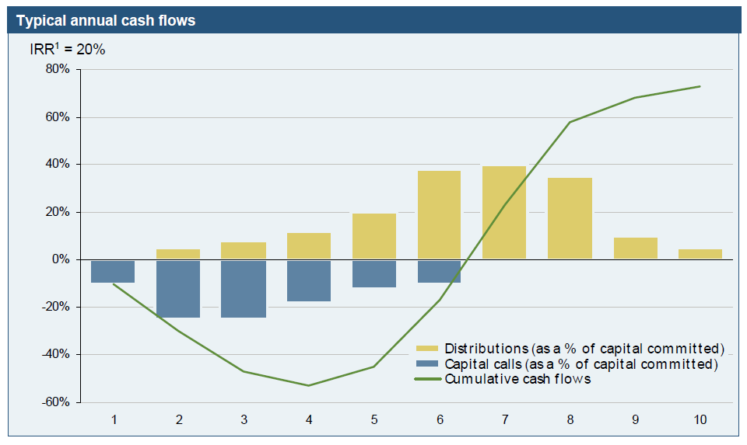
Private Equity’s J-Curve
Investors chip-in capital calls early during fund lifecycle: distributions typically come during mid-to-later years
Source: HKPEFA

Slide 32
Investment process
Initial Evaluation
Evaluate RFF (request for financing) and business plan
Very high rejection rate
Initial Negotiation
Discuss and negotiate general terms and structure of investment with entrepreneur/company before submission to investment committee for approval
Due Diligence
Sign Memorandum of Understanding (MOU)
Independent investigation of information
Final Negotiation and Completion
Key points include price, structure and role of the VC investor
Legal documentation to be signed
Monitoring
Exit
Generally 3-5 years after initial investment by IPO or to strategic partner
Source: HKVCA http://www.hkvca.com.hk/2004/m2-set.htm
Notes:
The investment process, from the initial evaluation stage to completion of documentation, usually takes a minimum of three to six months.
Initial Evaluation The request for financing, business plan (for companies already in operations) and audited financial statements must first be submitted to the venture capital firm which will then determine the merits of the proposal. During this process, many applications for funds will be turned down, as they do not fit into the venture capital firm's investment criteria.
Initial Negotiation Where a venture capitalist is interested in the project, he will discuss and negotiate the general terms and structure of the investment with the entrepreneur. He will then submit his recommendation to his Investment Committee for initial approval.
Due Diligence When the initial investment proposal is approved, a Memorandum of Understanding on the broad terms and structure will be agreed upon. It will be necessary at this stage for the venture capitalist to verify the facts and assumptions presented in the proposal. They will conduct further independent investigation on the product and its technology; the market and its competitors; and, the distribution network. Often the help of outside consultants and market research are sought. The financials plans are reviewed rigorously. During this process, full disclosure by the company is important, and the company's staff, suppliers, customers, banks, accountants and lawyers may be interviewed.
Final Negotiation and Completion Many issues will be covered, but the key points may be:
Price Using the data and insight obtained during the due diligence process, the venture capitalist will undertake a "valuation" of the company by application of price to earnings multiples, asset valuation and other required return calculations.
Structure The decision will be made on the amount of investment and whether it should take the form of equity, quasi-equity or other hybrid instruments (common shares, preferred shares, convertible loans, warrants, options). In buyouts it is normal for a new company to be formed to acquire the assets and trading liabilities. Debt financing if available will be simultaneously injected into the transaction at completion.
Role The extent of the venture capital investor's participation in the affairs of the company will be determined. This could involve representation at the board level, the appointment of a financial controller or other key management personnel, disclosure requirements, minority shareholders' protection and rights.
Upon formal approval of the investment by the venture capitalist's investment committee, legal documents will be prepared and signed. The shareholders' agreement will spell out the rights and obligations of both parties covering the terms of the investment, voting rights, sale arrangements, dividend policy, and venture capitalist's approval on matters that may affect the business plan.
Monitoring The venture capital firm's representatives on the company's board will be able to participate actively on all major decisions. The venture capitalist will also monitor its investment closely through regular reviews of financials and operations with management. It is usual in buyouts that the venture capital firm will control the board of the company.
Exit Venture capitalists typically exit the investment between 3-5 years after the investment date. Entrepreneur should be clear that venture capitalists require that an exit strategy be agreed with the entrepreneur before the investment is made and that this is constantly reviewed during the investment holding period.

Slide 33
The VC pipeline
10
investments
500 face to face meetings
1,200 initial reviews
(network introductions, conferences, in-bound inquiries, proactive efforts, portfolio company referrals, and seed investors)
50 due diligence
1% investment rate
Notes:
Source: “Here’s a look inside a typical VC’s pipeline (a must-read for entrepreneurs)” April 19, 2014 4:35 PM Sean Jacobsohn, Emergence Capital
http://venturebeat.com/2014/04/19/heres-a-look-inside-a-typical-vcs-pipeline-a-must-read-for-entrepreneurs/

Slide 34
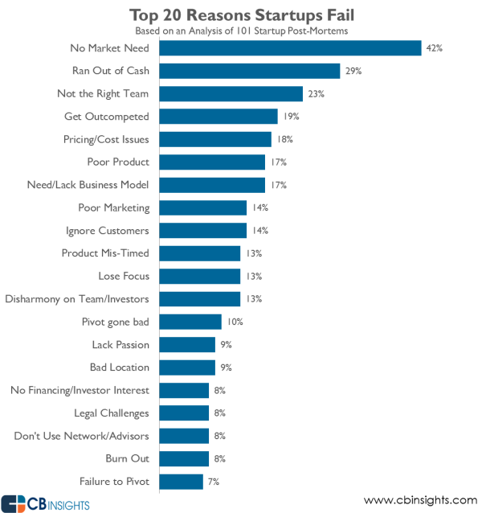
Top 20 reasons why start-ups fail
December 2015
Notes:
Source: CB Insights December 2015 https://www.cbinsights.com/blog/startup-failure-post-mortem/?utm_source=CB+Insights+Newsletter&utm_campaign=163e5221be-UnicornLeaks_12_06_2015&utm_medium=email&utm_term=0_9dc0513989-163e5221be-86659521&goal=0_9dc0513989-163e5221be-86659521

Slide 35
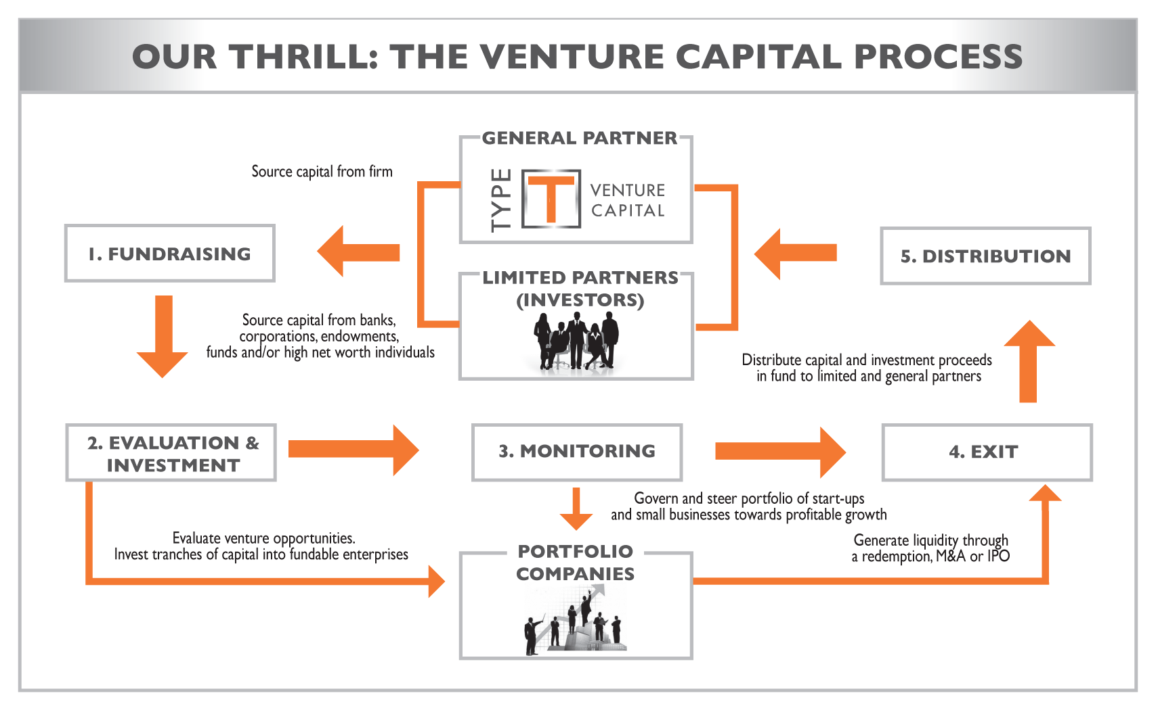
The Life Cycle of a PE Fund
Integration : Private Equity Process of Value Creators
Source: HKPEFA
35

Slide 36
Current Issues in PE and VC
A very public debate: “locusts” or public benefactors? Video: Other People’s Money https://www.youtube.com/watch?v=xJRhrow3Jws
Performance and fee structure
Disclosure and corporate governance issues
Growing participation of unsophisticated investors in PE (indirectly through pension funds and mutual funds)
Competition from corporate (CVC) and family offices
The shrinking IPO
Large amounts of dry powder => capacity to invest? Impact on valuations

Slide 37
SUMMARY
PE’s J-curve
PE/VC Investment process
Life Cycle of funds
Performance
CVC

Slide 38
Test Your Understanding
Your friend, who is in his final year of engineering studies at HKUST, has discovered a way of making tele-transportation work. He is now looking to build a prototype of his machine, and asks for your guidance in seeking funding to start his new business. Which type of financial institution would you recommend he try?
A commercial bank
A hedge fund
A seed (venture capital) fund
A mutual fund

Slide 39
Current issues: Private Equity Funds in Asia: what is the trend? What is happening in China? In India? What are the issues? Implications?(Group 17)
Videos
https://www.brightmc.org/post/5-trends-for-private-equity-venture-capital-in-asia
Articles
https://www.bcg.com/publications/2020/navigating-growing-asia-pacific-private-equity-market

Slide 40
Course Map
Overview
Financial Institutions
Sovereign Wealth Funds
Private Equity and Venture Capital
Hedge Funds
Sell Side
Buy Side
Commercial Banking
Traditional Institutional Investors
Investment Banking
Alternative Investors

Slide 41
What is a Hedge Fund?
Surprisingly, there is no official legal definition.
Some examples of definitions:
“a limited partnership, which can take long and short positions, use leverage, and pay to the manager (principal partner) 20% of their profit. The manager has usually invested his own money”. (Alfred Winslow Jones)
“a mutual fund that employs leverage and uses various techniques of hedging”. (G. Soros)
“all investment funds with an absolute return goal”. (TASS)
“a risky investment pool, generally open only to well-heeled investors, that seeks very high returns by taking very great risks”. (Money Central Investor)
Source: Prof F.S. Lhabitant

Slide 42
What is a hedge fund?
A hedge fund constitutes an investment program whereby the managers or partners seek absolute returns by exploiting investment opportunities while protecting principal from potential financial loss. The first hedge fund was indeed a hedged fund.
The reason the term “hedge fund” is perceived as a misnomer is because there are no hedge funds that hedge all risks. If all risks were hedged, so would be the returns.
This definition highlights two important aspects of hedge funds: the attempt to generate positive absolute returns by taking risk and, at the same time, trying to control losses and avoid negative compounding of capital. Their investment philosophy is materially different from the investment philosophy of a manager who is tied to a market benchmark.
The hedge funds/alternative investment moniker is a description of what an investment fund is not rather than what it is. The universe of alternative investments is just that – the universe.
Source: AIMA Roadmap to Hedge Funds Nov 08
Notes:
Source: http://www.aima.org/en/knowledge_centre/education/aimas-roadmap-to-hedge-funds.cfm

Slide 43
Hedge Funds Characteristics
Actively managed – returns driven by manager skills (“alpha”).
No benchmarks, no relative weights, no relative returns.
Flexible investment policies.
Often located “offshore”.
Limited liquidity.
Performance fees – the 2+20 system
Run by partners, not employees
Secretive
Source: Prof F.S. Lhabitant

Slide 44
Who are the investors?
Originally, for PE and HF, investors were primarily HNWI and family offices
Over time, the role of institutional investors has increased
The flow of money from institutionals increased due to the search for yield post-GFC
Recently, hedge funds under-performance has caused many withdrawals from key investors, particularly US pension funds

Slide 45
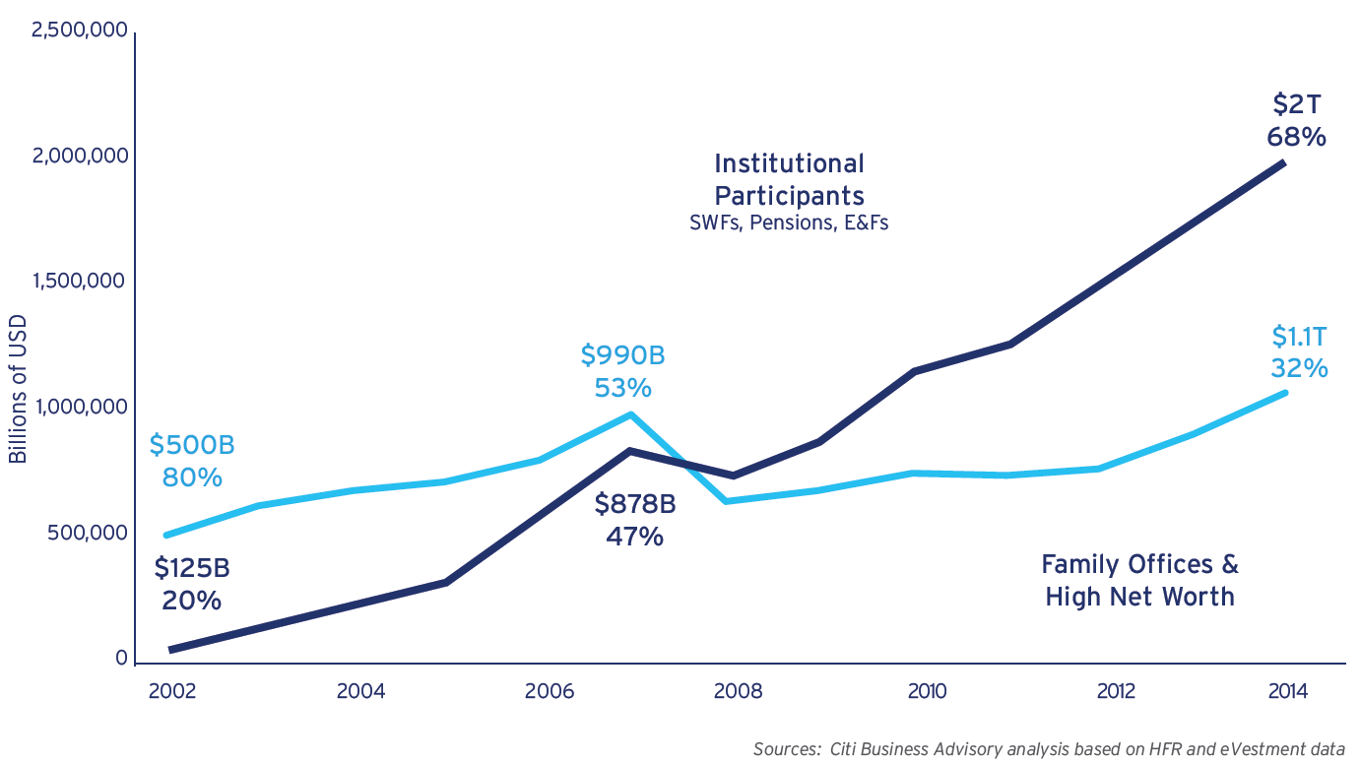
Sources of underlying capital directed to HF industry
Notes:
Source: Citibank’s 6th annual survey of asset managers June 15

Slide 46
Key Features of Hedge Funds
Organizational structure: private partnership in US: limited partners (investors) v. general partners (manager)
Fee structure: 2/20: management fee and performance fee, hurdle rate, high water mark
Term structure: lock up and redemption features; side pockets
Strategy diversity: global macro; directional (inc. long/short); event-driven; relative value…
Notes:
Redemptions and Lockup Periods
Redemptions are restricted by lock-up periods and required notices well before the redemption. Hedge funds restrict redemptions so that the fund manager is not forced to sell or close out positions when it would be detrimental simply because investors are panicking. Sometimes the hedge funds can borrow the money to pay for redemptions, but if there are too many at one time, then the fund will have less collateral for loans, and therefore, will need to close out positions to generate the cash for redemptions. Sometimes, the banks won’t accept the collateral as is occurring now (Aug, 2007) with assets based on subprime mortgages. Because funds of hedge funds invest in these hedge funds, they, too, are required to give adequate notice of redemptions, and so they must require similar notices from their own customers. In most cases, however, funds of hedge funds allow monthly or quarterly redemptions.
Hedge funds typically have an initial 1- to 5-year lockup period during which the investor cannot redeem any shares, although most funds have a lockup period of less than 3 years. Only the best performing hedge funds can demand the longer lockup periods. Some hedge funds have a lock-up period of 2 years or longer so that the managers can avoid registering with the SEC. A new SEC rule—in force since February, 2006—requires that all managers of hedge funds with a lock-up period of less 2 years to register as investment advisers. The 2-year rule was added so that venture capitalists and managers of private equity funds wouldn’t have to register as investment advisers.
Longer lockups benefit the hedge fund because it offers greater stability, and a guaranteed cash flow generated by the asset management fee, which allows the funds to attract top managers by offering better pay. Longer lockups also allow a fund to invest in illiquid assets that may take time to generate good returns, such as investments in private equity.
After the lock-up period, some hedge funds limit redemptions to once a quarter, and most hedge funds require a 15- to 90-day notice for redemptions.
Many funds offer different classes of shares with different lockup periods, notice requirements for redemptions, or redemption fees.
Redemptions may reduce the performance of the fund, especially in a down market, because the fund may be forced to sell securities at a loss, and because of leverage, it may be forced to sell more securities than would otherwise be necessary to maintain its margin maintenance requirement. Redemptions may cascade into more redemptions as nervous investors bail out of the market. Losses may also mount because the hedge funds use similar methods in deciding what to buy and sell, so if 1 hedge fund needs to liquidate to pay for redemptions or because it is overleveraged, it may cause market signals that cause other hedge funds to sell or close their positions also.
Another factor that can accelerate redemptions is if investors of funds of hedge funds want to redeem their shares. Doing so, forces these funds of hedge funds to redeem their shares in the hedge funds that they invested in, which forces the hedge funds to redeem more shares and liquefy their portfolios to pay for the redemption.
There are usually many investment opportunities in a major sell-off. Only hedge funds with longer lockup periods who don’t have to worry about customer redemptions can take advantage of these opportunities.
Source: http://thismatter.com/money/funds/hedge-funds/hedge-funds.htm
Side pockets
Where a hedge fund holds assets that are hard to value reliably or are relatively illiquid (in comparison to the redemption terms of the fund itself), the fund may employ a "side pocket". A side pocket is a mechanism whereby the fund segregates the illiquid assets from the main portfolio of the fund and issues investors with a new class of interests or shares which participate only in the assets in the side pocket. Those interests/shares cannot be redeemed by the investor. Once the fund is able to sell the side pocket assets, the fund will generally redeem the side pocket interests/shares and pay investors the proceeds.
Side pockets are designed to address issues relating to the need to value investors' holdings in the fund if they choose to redeem. If an investor redeems when certain assets cannot be valued or sold, the fund cannot be confident that the calculation of his redemption proceeds would be accurate. Moreover, his redemption proceeds could only be obtained by selling the liquid assets of the fund. If the illiquid assets subsequently turned out to be worth less than expected, the remaining investors would bear the full loss while the redeemed investor would have borne none. Side pockets therefore allow a fund to ensure that all investors in the fund at the time the relevant assets became illiquid will bear any loss on them equally and allow the fund to continue subscriptions and redemptions in the meantime in respect of the main portfolio. A similar problem, inverted, applies to subscriptions during the same period.
Side pockets are most commonly used by funds as an emergency measure. They were used extensively following the collapse of Lehman Brothers in September 2008, when the market for certain types of assets held by hedge funds collapsed, preventing the funds from selling or obtaining a market value for the assets.
Specific types of fund may also use side pockets in the ordinary course of their business. A fund investing in insurance products, for example, may routinely side pocket securities linked to natural disasters following the occurrence of such a disaster. Once the damage has been assessed, the security can again be valued with some accuracy.
Source: http://en.wikipedia.org/wiki/Hedge_fund
The legal entity
Limited partnerships are principally used for hedge funds aimed at US-based investors who pay tax, as the investors will receive relatively favorable tax treatment in the US. The general partner of the limited partnership is typically the investment manager (though is sometimes an offshore corporation) and the investors are the limited partners. Offshore corporate funds are used for non-U.S. investors, which would otherwise be subject to more complex tax issues by investing in a tax-transparent entity such as a partnership, and U.S. entities that do not pay tax such as pension funds, which would otherwise be subject to unrelated business income tax in the United States. Unit trusts are sometimes used to market to Japanese investors. Other than taxation, the type of entity used does not have a significant bearing on the nature of the fund.
Many hedge funds are structured as master-feeder funds. In such a structure, the investors will invest into a feeder fund, which will, in turn, invest all of its assets into the master fund. The assets of the master fund will then be managed by the investment manager in the usual way. This allows several feeder funds (e.g. an offshore corporate fund, a U.S. limited partnership and an entity established for a particular investor) to invest into the same master fund, allowing an investment manager the benefit of managing the assets of a single entity while giving all investors the best possible tax treatment. The master fund will be tax-transparent for US tax purposes.
The investment manager, which will have organized the establishment of the hedge fund, may retain an interest in the hedge fund, either as the general partner of a limited partnership or as the holder of “founder shares” in a corporate fund. Founder shares typically have no economic rights, and voting rights over only a limited range of issues, such as selection of the investment manager. The fund’s strategic decisions are taken by the board of directors of the fund, which is independent but generally loyal to the investment manager.

Slide 47
HF Glossary
Alpha: Measures the value that an investment manager produces, by comparing the manager’s performance to that of a risk-free investment (usually a Treasury bill).
Beta: Gauges the risk of a fund by measuring the volatility of its past returns in relation to the returns of a benchmark, such as the S&P 500 index.
High-water mark: A provision serving to ensure that a fund manager only collects incentive fees on the highest net asset value previously attained at the end of any prior fiscal year - or gains representing actual profits for each investor. A high water mark means that, where the net asset value (NAV) of the fund drops below its peak, no performance fee can be charged on any subsequent profit until the NAV reaches its previous high.
Sources: BNA International/AIMA

Slide 48
HF Glossary (Cont)
Hurdle rate: The minimum return necessary for a fund manager to start collecting incentive fees. The hurdle is usually tied to a benchmark rate such as Libor or the one-year Treasury bill rate plus a spread.
The deployment of a hurdle rate in a hedge fund means that a hedge fund manager cannot charge a performance fee until the fund’s performance exceeds a pre-determined target. So, for example, if a fund sets a hurdle of 5% and returns 15%, performance fees would only apply to the 10% above the hurdle. This target can be pre-specified as a fixed percentage (anything between 0.1% and 10%) or an index based benchmark (usually LIBOR or LIBOR plus a spread).
Sources: BNA International & AIMA
Notes:
Alpha: Measures the value that an investment manager produces, by comparing the manager’s performance to that of a risk-free investment (usually a Treasury bill). For example, if a fund had an alpha of 1.0 during a given month, it would have produced a return during that month that was one percentage point higher than the benchmark Treasury. Alpha can also be used as a measure of residual risk, relative to the market in which a fund participates
Beta: Gauges the risk of a fund by measuring the volatility of its past returns in relation to the returns of a benchmark, such as the S&P 500 index. A fund with a beta of 0.7 has experienced gains and losses that are 70 percent of the benchmarks changes. A beta of 1.3 means the total return is likely to move up or down 30 percent more than the index. A fund with a 1.0 beta is expected to move in sync with the index.
High-water mark: A provision serving to ensure that a fund manager only collects incentive fees on the highest net asset value previously attained at the end of any prior fiscal year - or gains representing actual profits for each investor. For example, if the value of an investors contribution falls to, say, USD$750,000 from USD $1 million during the first year, and then rises to USD $1.25 million during the second year, the manager would only collect incentive fees from that investor on the USD $250,000 that represented actual profits in year-two.
Hurdle rate: The minimum return necessary for a fund manager to start collecting incentive fees. The hurdle is usually tied to a benchmark rate such as Libor or the one-year Treasury bill rate plus a spread. If, for example, the manager sets a hurdle rate equal to 5 percent, and the fund returns 15 percent, incentive fees would only apply to the 10 percent above the hurdle rate.
Incentive fee (performance fee): The charge - typically 20 percent - that a fund manager assesses on gains earned during a given 12-month period. For example, if a fund posts a return that is 40 percent above its hurdle rate, the incentive fee would be 8 percent (20 percent of 40 percent) - provided that the high-water mark does not come into play.
Management fee: The charge that a fund manager assesses to cover operating expenses. Investors are typically charged separately for costs incurred for outsourced services. The fee generally ranges from an annual 0.5 percent to 2 percent of an investors entire holdings in the fund, and it is usually collected on a quarterly basis.
General partner: The individual or firm that organizes and manages a limited partnership, such as a hedge fund. The general partner assumes unlimited legal responsibility for the liabilities of a partnership
Limited partnership: Many hedge funds are structured as limited partnerships, which are business organizations managed by one or more general partners who are liable for the funds debts and obligations. The investors in such a structure are limited partners who do not participate in day-to-day operations and are liable only to the extent of their investments.
Sortino ratio: Also called the “upside potential ratio.” Similar to the Sharpe ratio, it was developed by the Pension Research Institute to determine the amount of “good” volatility that a funds investment portfolio possesses - that is, it seeks to define the amount by which the investment pool’s value may increase, based on expected pricing fluctuations
Soft dollars: Credits that can be used to pay for research and other services that brokerage firms provide to hedge funds and other investor clients in return for their business. Those credits are accumulated through soft-dollar brokers, which channel trades to multiple securities brokers.
R-squared: A measure of the degree to which a hedge funds returns are correlated to the broader financial market. A figure of 1 would be a perfect correlation, while 0 would be no correlation and minus-1 would be a perfect inverse correlation. Any figure below 0.3 is considered non-correlated. The result is used to determine whether a hedge fund follows a market-neutral investment strategy. Sometimes referred to as “R.”
Sharpe ratio: A measure of how well a fund is rewarded for the risk it incurs. The higher the ratio, the better the return per unit of risk taken. It is calculated by subtracting the risk-free rate from the fund’s annualized average return, and dividing the result by the funds annualized standard deviation. A Sharpe ratio of 1:1 indicates that the rate of return is proportional to the risk assumed in seeking that reward. Developed by Prof. William R. Sharpe of Stanford University.

Slide 49
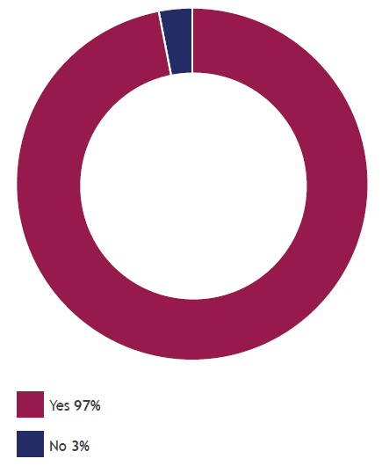
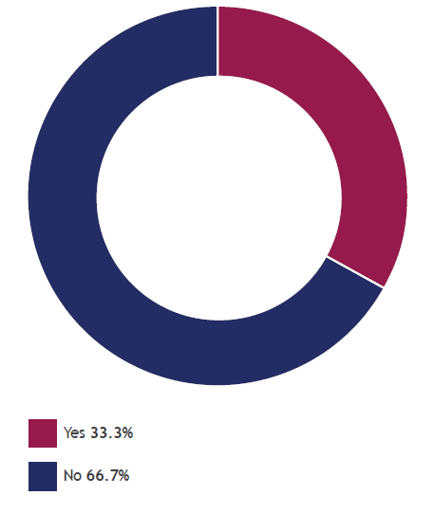
97% of HF managers use high water mark, 1/3 use hurdle rates
High
Water
Mark
Hurdle
Rate
Source: AIMA Survey Sept 2016
Notes:
Source: AIMA Survey Sept 2016 https://www.aima.org/en/document-summary/index.cfm/docid/85FCC93E-D908-4B71-89DD763CDF7F88AF

Slide 50
HF Glossary (Cont)
Incentive fee (performance fee): The charge - typically 20 percent - that a fund manager assesses on gains earned during a given 12-month period.
Management fee: The charge that a fund manager assesses to cover operating expenses. Investors are typically charged separately for costs incurred for outsourced services. The fee generally ranges from an annual 0.5 percent to 2 percent of an investors entire holdings in the fund, and it is usually collected on a quarterly basis.
Lock Up: Investors cannot redeem capital for a certain period. the committed capital gives greater freedom to the hedge fund manager who does not need to hold as much cash on hand to meet potential redemption requests.
Sources: BNA International/AIMA

Slide 51
SUMMARY
HF definition
HF Characteristics & Key Features
HF Glossary

Slide 52
Test Your Understanding
Which of the following are common characteristics of both hedge funds and private equity funds?
Organizational structure as partnerships
Fee structure with a combination of management fee and performance fee
High denomination
High portfolio diversification
A, b and c
B c and d
A c and d
A b and d
All of the above
None of the above

Slide 53
Top Hedge Fund Managers by AuM as of June 2018
Source: Prequin

Slide 54
Hedge Funds launched, by strategy

Slide 55
Funds of Hedge Funds
"Funds of hedge funds," a relatively new type of investment product, are investment companies that invest in hedge funds.
Some, but not all, register with the SEC and file semi-annual reports.
They often have lower minimum investment thresholds than traditional, unregistered hedge funds and can sell their shares to a larger number of investors.
Like hedge funds, funds of hedge funds are not mutual funds.
Unlike open-end mutual funds, funds of hedge funds offer very limited rights of redemption.
And, unlike ETFs, their shares are not typically listed on an exchange.
If you invest in hedge funds through a fund of hedge funds, you will pay two layers of fees: the fees of the fund of hedge funds and the fees charged by the underlying hedge funds.
Source: SEC
Notes:
"Hedge fund" is a general, non-legal term used to describe private, unregistered investment pools that traditionally have been limited to sophisticated, wealthy investors. Hedge funds are not mutual funds and, as such, are not subject to the numerous regulations that apply to mutual funds for the protection of investors - including regulations requiring a certain degree of liquidity, regulations requiring that mutual fund shares be redeemable at any time, regulations protecting against conflicts of interest, regulations to assure fairness in the pricing of fund shares, disclosure regulations, regulations limiting the use of leverage, and more.
"Funds of hedge funds," a relatively new type of investment product, are investment companies that invest in hedge funds. Some, but not all, register with the SEC and file semi-annual reports. They often have lower minimum investment thresholds than traditional, unregistered hedge funds and can sell their shares to a larger number of investors. Like hedge funds, funds of hedge funds are not mutual funds. Unlike open-end mutual funds, funds of hedge funds offer very limited rights of redemption. And, unlike ETFs, their shares are not typically listed on an exchange.

Slide 56
Current Issues about Hedge Funds
Impact of crisis
Need for regulation of HF?
Investors in HFs
New regulations post-crisis: Dodd-Frank Act 2010 and Private Fund Investment Advisers Registration Act of 2010 (US); Alternative Investment Fund Directive 2010 (EU)
Performance results and fee structure
Are hedge funds the new mutual funds?
Confidence and withdrawals
Impact of Madoff scandal: are HFs just a Ponzi scheme?
Impact on feeder funds and funds of funds
Impact on results and performance
Notes:
Title IV of the Dodd-Frank Wall Street Reform and Consumer Protection Act, referred to as the Private Fund Investment Advisers Registration Act of 2010, requires certain private fund advisers previously exempt from SEC registration to register as investment advisers under the Investment Advisers Act of 1940. The Act defines "private funds" as those funds relying on Sections 3(c)(1) or 3(c)(7) of the Investment Company Act of 1940 to avoid registration and as such generally encompasses hedge funds, private equity funds and venture capital funds. The Act eliminates the previous private adviser exemption, which generally exempted from SEC registration advisers with fewer than 15 clients and which did not hold themselves out publicly as advisers. The Act also eliminates a private fund adviser's ability to avoid registration under the "intrastate adviser" exemption found in Section 203(b)1 of the IAA. It should be noted that most of the Act's provisions will not become effective until a year after enactment, giving private fund advisers time to prepare for the new regulatory framework.
The Alternative Investment Fund Managers Directive 2009/0064/COM is a proposed European Union law which will put hedge funds and private equity funds under the supervision of an EU regulatory body. These kinds of business vehicle have not been subject to the same rules to protect the investing public as mutual and pension funds. Lack of financial regulation is widely seen to have contributed to the severity of the global financial crisis. The European Parliament voted through a final text of the Directive on 11 November 2010.
The AIFMD proposal includes the following reforms.
A private equity fund must appoint an independent valuer and an independent custodian.
Private equity fund with EU investors must disclose its business plan for a portfolio company to that company, its other shareholders and employees and make that information public.
Investors would not be able to invest outside the EU unless it was under an "equivalent" regime
Imposes limit to leverage for one time the amount of capital across a fund.
The think tank Open Europe has estimated that the hedge fund and private equity industry contribute €9.2 billion in tax revenues to the EU economy every year, which would come under threat if the EU's AIFM directive would have been passed in its original flawed form.^{[2]}
Source: http://europa.eu/rapid/pressReleasesAction.do?reference=MEMO/10/572&format=HTML&aged=0&language=EN&guiLanguage=en
What is an Alternative Investment Fund Manager (‘AIFM’)?
An AIFM is a manager of an alternative investment fund. The term alternative investment fund encompasses a wide range of investment funds that are not already regulated at European level by the UCITS Directive (IP/10/869). They include hedge funds, private equity funds, real estate funds and a wide range of other types of institutional fund. The AIFMD is therefore much more than a ‘hedge fund directive’.
The AIFMD will not apply to entities such as governments managing funds supporting social security and pension systems; supranational institutions, such as the World Bank and member organizations of the World Bank Group; and other entities expressly excluded from its scope.
What are the objectives of the AIFMD?
The overarching objective of the AIFMD is to create, for the first time, a comprehensive and secure framework for the supervision and prudential oversight of AIFM in the EU. Once the AIFMD enters into force, all AIFM will be required to obtain authorisation and will be subject to ongoing regulation and supervision. In this way, the AIFMD will:
Increase the transparency of AIFM towards investors, supervisors and the employees of the companies in which they invest;
Equip national supervisors, the European Securities Markets Agency (‘ESMA’) and the European Systemic Risk Board (‘ESRB’) with the information and tools necessary to monitor and respond to risks to the stability of the financial system that could be caused or amplified by AIFM activity;
Introduce a common and robust approach to the protection of investors in these funds;
Strengthen and deepen the single market, thereby creating the conditions for increased investor choice and competition in the EU, subject always to high and consistent regulatory standards; and
Increase the accountability of AIFM holding controlling stakes in companies (private equity) towards employees and the public at large.
Have the United States introduced new rules for this sector?
Effective regulation of the financial markets requires consistent and effective action to be taken in all major jurisdictions. In this and other areas, the commitments made by the G20 leaders provide the framework for this action.
In accordance with these G20 commitments, as in Europe, the United States have acted to strengthen regulation in this area. New rules on hedge funds and private equity were adopted in July as part of the Dodd-Frank Act. These rules will require the registration of managers of private equity and hedge funds with the Securities and Exchange Commission. Managers will be subject to substantive regulatory requirements and will be required to report regularly to supervisors for the purposes of systemic risk by the newly-created Financial Stability Oversight Council.
The objectives and approach of these reforms are consistent with those of the AIFMD
What is the 'passport'?
The AIFMD introduces for the first time a genuine ‘single market framework’ for this sector, which will allow AIFM to ‘passport’ their services throughout the EU on the basis of a single authorisation.
Specifically, once an AIFM is authorised under the AIFMD in one Member State and complies with the rules of the directive, this manager will be entitled upon notification to manage or market funds to professional investors throughout the EU.
By creating a single regulatory and supervisory regime for all AIFM active in the EU, the AIFMD will help market participants to overcome the barriers and inefficiencies created by the current patchwork of national regulation. This will help to increase choice and competition, to the benefit of European investors.
When will the passport be made available to non-EU managers and funds?
Alternative investments are a global industry and it is important that European investors have access to the best that the global market has to offer. At the same time, it is imperative that all AIFM active in the EU are subject to the same high standards of transparency and conduct, irrespective of where they, or the funds they manage, are located.
Following a limited transition period of two years, and subject to the conditions set out in the AIFMD, the passport will be extended to the marketing of non-EU funds, managed both by EU AIFM and AIFM based outside the EU. In accordance with the principle of ‘same rights, same obligations’, this approach will ensure a level playing field and a consistently high level of transparency and protection of European investors.
The phased introduction of the third country passports will allow European supervisors to ensure that the appropriate controls and cooperation arrangements necessary for the effective supervision of non-EU AIFM are operating effectively.
Before the third country passport is introduced and for a period of three years thereafter, national regimes will remain available subject to certain harmonized safeguards. Once this period has elapsed and on the basis of conditions set out in the AIFMD, a decision will be taken to eliminate the parallel national regimes. At this point, all AIFM active in the EU will be subject to the same high standards and will enjoy the same rights.

Slide 57
Current issues: hedge fund performance

Slide 58
Current issues: Hedge Funds in Asia: what is the trend? What is the performance? What are the issues?(Group 16)
Videos
https://www.youtube.com/watch?v=j5GJa3o4C30
Articles
https://home.kpmg/cn/en/home/news-media/press-releases/2020/09/asia-hedge-funds-continue-to-hire-in-2020-despite-covid19.html

Slide 59
Hedge Funds in Hong Kong
The number of hedge funds managed by SFC-licensed hedge fund managers in Hong Kong increased from 676 in 2012 to 778 as of 30 September 2014.
The total hedge fund AUM in Hong Kong expanded from US$87.1 billion in 2012 to US$120.9 billion as of 30 September 2014, an increase of 38.8%. The total hedge fund AUM in Hong Kong surpassed its peak in 2008 and represented over 13 times the US$9.1 billion AUM in 2004, the earliest year covered by our surveys
Equity long/short strategies and multi-strategies remained the most popular. For multi-strategies, the most common underlying strategies were equity long/short, event driven (equity special situations) and equity hedge (market neutral).
Investments remained focused on the Asia Pacific markets, which accounted for 63.9% of the total hedge fund AUM. Hong Kong and mainland China accounted for 31.7%.
American and European Union investors represented 61.3% of the total AUM managed in Hong Kong while Hong Kong-based investors accounted for 7.9%.
Major investor type was institutional investors, (66.9%) such as funds of funds, financial institutions, pension funds, endowments/foundations, sovereign wealth funds and government-related entities.
Source: SFC
Notes:
Source: Report of the Survey on Hedge Fund Activities of SFC-licensed Managers/Advisors SFC March 15
http://www.sfc.hk/web/EN/files/ER/Reports/HF%20Survey%20Report%202015_En.pdf

Slide 60
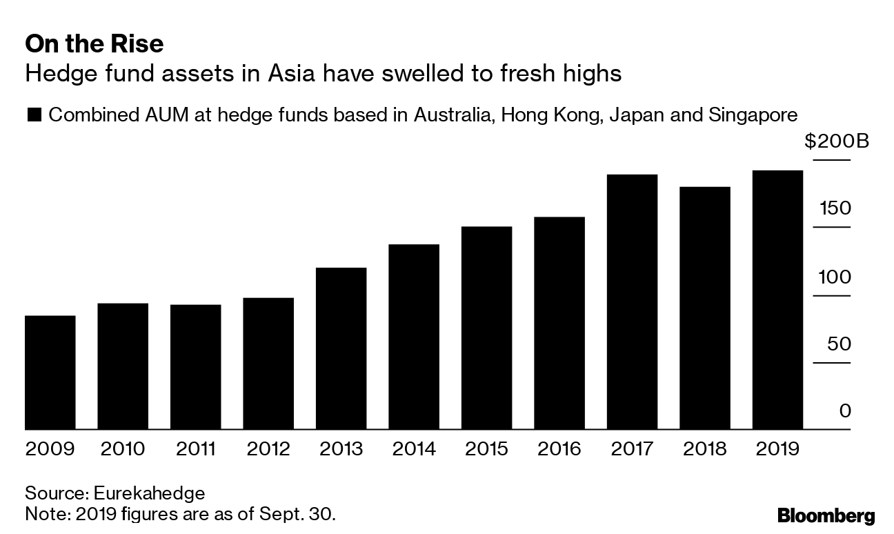
HF AuM in Asia
Notes:
Source: Bloomberg 29 Oct 19 https://mail.google.com/mail/u/0/#inbox/FMfcgxwDrvDcMXPHlcbLlBFNfXVWVchT?projector=1

Slide 61
SUMMARY
Funds of Hedge Funds

